Slide 1
Linear Algebra

Slide 2
The course of “Linear Algebra” includes the following topics:
Systems of linear equations. Elementary row operations. Gaussian Elimination method of solving the system of equations
Matrices, types of matrices, transpose of a matrix. Operations on matrices: addition, subtraction and multiplication of a matrix by a scalar, multiplication of matrices

Slide 3
Matrix representation of a system of equations. Echelon form of a matrix, rank of a matrix. Distinguishing between consistent and inconsistent system of equations based on rank of matrices
Determinant of a matrix, its properties. Calculating of determinants by expansion in the row or the column using the minors and cofactors.
Solving the system of equations by using Cramer’s rule. Inverse of a matrix. Solving the system of equations by using inverse matrix.

Slide 4
Applications to systems of linear equations. Solving real-life and engineering problems by using the system of equations.
Vector spaces. Definitions and examples. Subspaces and spanning sets. Linear combinations, linear dependence and independence. Dot product, vector product.
Basis and dimension. Change of basis. Orthonormal vectors. Gram-Schmidt Orthogonalization.

Slide 5
Linear transformations. Matrix representations of linear transformations.
Algebra of linear operators. Matrix representations of linear operator.
Eigenvalues and eigenvectors. Characteristic polynomial.
Diagonalization of a matrix.

Slide 6
System of linear equations
System of linear equations is a set of two or more linear equations. A solution to a system of equations is an ordered pair that satisfy all the equations in the system.
A system of linear equations can have:
Exactly one solution
No solutions
Infinitely many solutions

Slide 7
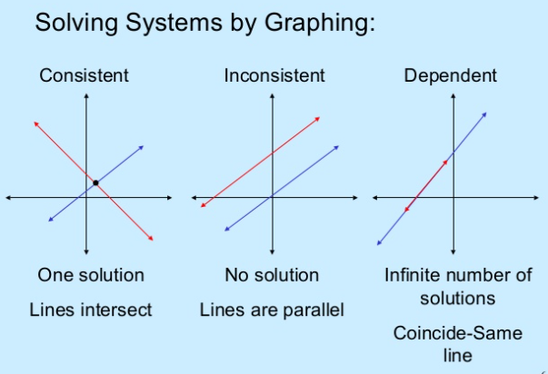
Systems of linear equations can be solved by different ways: graphically, by substitution or by elimination.

Slide 8
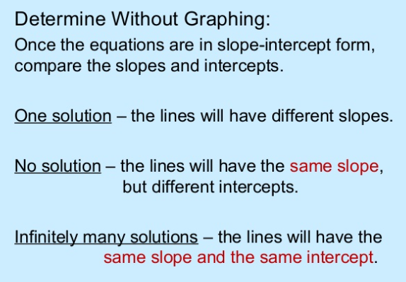

Slide 9

Example 1. Solve the system of equations:
$a)\left\{\begin{aligned}2x+y=5 \\ x+y=3\end{aligned}\right.$ $b) \left\{\begin{aligned}5x+20y=25 \\ 4x−7y=−26\end{aligned}\right.$

Slide 10
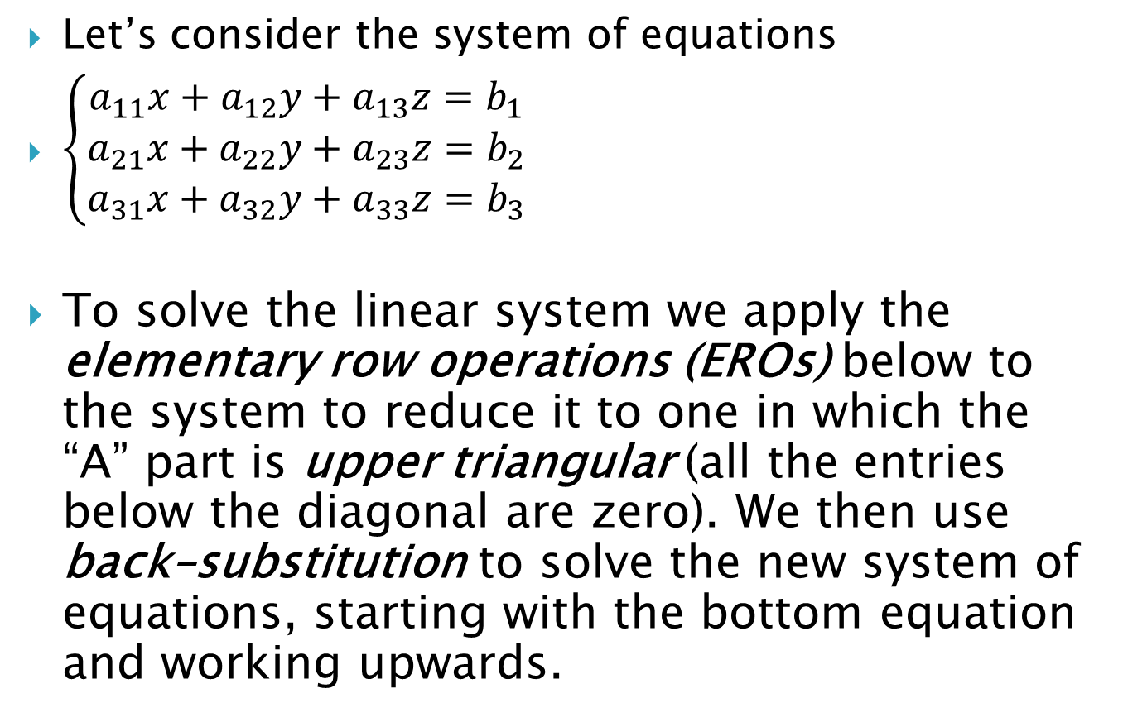
Let’s consider the system of equations
$\left\{\begin{aligned}a_{11}x+a_{12}y+a_{13}z=b_{1} \\ a_{21}x+a_{22}y+a_{23}z=b_{2} \\ a_{31}x+a_{32}y+a_{33}z=b_{3}\end{aligned}\right.$
To solve the linear system we apply the elementary row operations (EROs) below to the system to reduce it to one in which the “A” part is upper triangular (all the entries below the diagonal are zero). We then use back–substitution to solve the new system of equations, starting with the bottom equation and working upwards.

Slide 11
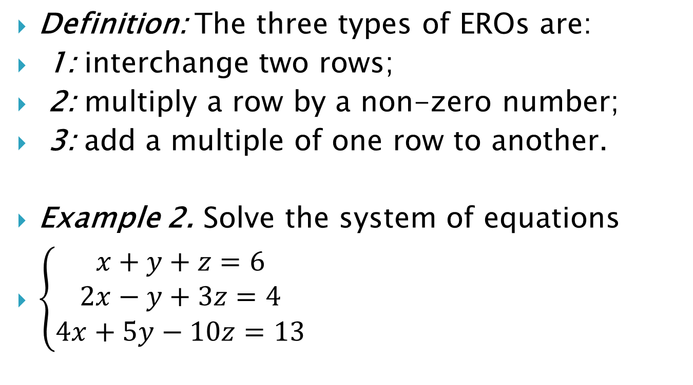
Definition: The three types of EROs are:
1: interchange two rows;
2: multiply a row by a non-zero number;
3: add a multiple of one row to another.
Example 2. Solve the system of equations
$\left\{\begin{aligned}x+y+z=6 \\ 2x−y+3z=4 \\ 4x+5y−10z=13\end{aligned}\right.$

Slide 12

Example 3. Use elementary row operations to solve the system of equations
$\left\{\begin{aligned}2x+5y+4z=4 \\ x+4y+3z=1 \\ x−3y−2z=5\end{aligned}\right.$

Slide 13
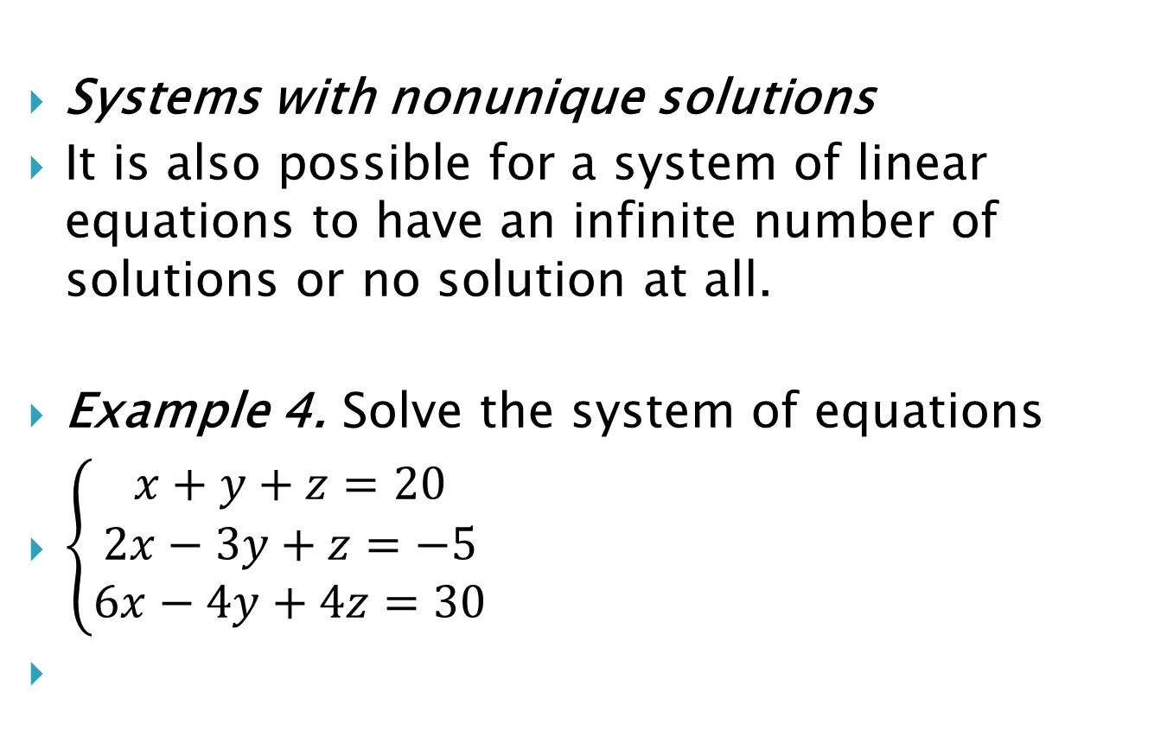
Systems with nonunique solutions
It is also possible for a system of linear equations to have an infinite number of solutions or no solution at all.
Example 4. Solve the system of equations
$\left\{\begin{aligned}x+y+z=20 \\ 2x−3y+z=−5 \\ 6x−4y+4z=30\end{aligned}\right.$

Slide 14
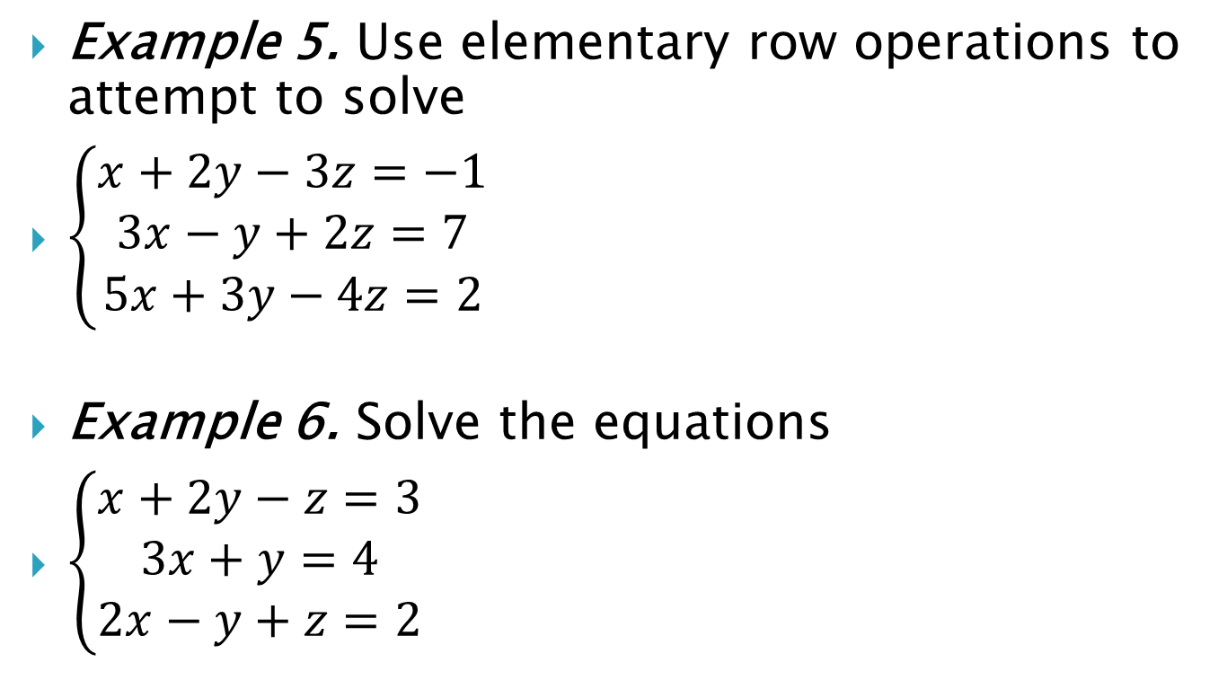
Example 5. Use elementary row operations to attempt to solve
$\left\{\begin{aligned}x+2y−3z=−1 \\ 3x−y+2z=7 \\ 5x+3y−4z=2\end{aligned}\right.$
Example 6. Solve the equations
$\left\{\begin{aligned}x+2y−z=3 \\ 3x+y=4 \\ 2x−y+z=2\end{aligned}\right.$

